Slide 1
Anomaly Detection
Zhu yiling

Slide 2
Image-level anomaly detection
Classification target
Adversarially Learned One-Class Classifier for Novelty Detection [ALOCC] | Mohammad Sabokrou, et al. | [CVPR' 18]
Hierarchical Novelty Detection for Visual Object Recognition | Kibok Lee, et al. | [CVPR' 18]
Deep One-Class Classification | Lukas Ruff, el al. | [ICML' 18]
Deep Anomaly Detection with Outlier Exposure | Dan Hendrycks, et al. | [ICLR' 19]
Latent Space Autoregression for Novelty Detection | Davide Abati, et al. | [CVPR' 19]
OCGAN: One-Class Novelty Detection Using GANs With Constrained Latent Representations | Pramuditha Perera, et al. | [CVPR' 19]
Notes:
https://github.com/hoya012/awesome-anomaly-detection
https://www.dlology.com/blog/how-to-do-novelty-detection-in-keras-with-generative-adversarial-network/
https://github.com/khalooei/ALOCC-CVPR2018

Slide 3
Image-level anomaly detection
Segmentation target
Unsupervised Anomaly Detection with Generative Adversarial Networks to Guide Marker Discovery [AnoGAN] | Thomas Schlegl, et al. | [IPMI' 17]
Improving Unsupervised Defect Segmentation by Applying Structural Similarity to Autoencoders | Paul Bergmann, et al. | [arXiv' 18]
Deep Autoencoding Models for Unsupervised Anomaly Segmentation in Brain MR Images | Christoph Baur, et al. | [arXiv' 18]
AVID: Adversarial Visual Irregularity Detection | Mohammad Sabokrou, et al. | [arXiv' 18]
MVTec AD -- A Comprehensive Real-World Dataset for Unsupervised Anomaly Detection | Paul Bergmann, et al. | [CVPR' 19]
Exploiting Epistemic Uncertainty of Anatomy Segmentation for Anomaly Detection in Retinal OCT | Philipp Seeböck, et al. | [IEEE TMI' 19]
Notes:
https://github.com/hoya012/awesome-anomaly-detection

Slide 4
Anomaly Detection
GAN
AnoGAN 、f-AnoGAN、GANomaly、Skip-ganomaly、Efficient-GAN、fence GAN
Structured Representations
Patch GAN、 spatial VAE、structed based VAE
VAE
VAE+GAN AAE+GAN VAE+pixel CNN
loss
SSIM loss GAN loss perceptual loss
CNN
Unet+Partial CNN

Slide 5
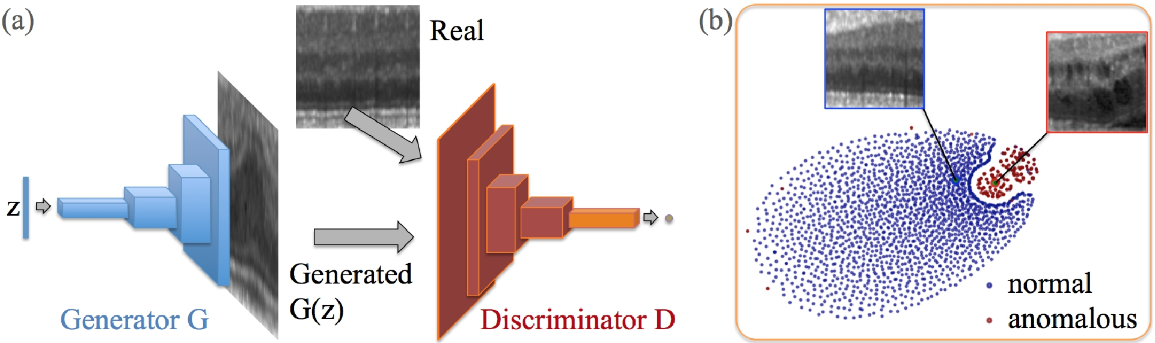
anoGAN for Unsupervised Anomaly Detection
(a) Deep convolutional generative adversarial network. (b) t-SNE embedding of normal (blue) and anomalous (red) images on the feature representation of the last convolution layer (orange in (a)) of the discriminator
Schlegl, Thomas, et al. "Unsupervised anomaly detection with generative adversarial networks to guide marker discovery." International Conference on Information Processing in Medical Imaging. Springer, Cham, 2017.
Notes:
http://tongtianta.site/paper/4538

Slide 6
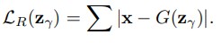
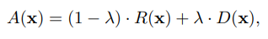
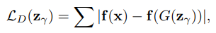
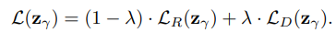
anoGAN for Unsupervised Anomaly Detection
residual loss:
Discrimination Loss:
Only the coeﬃcients of z are adapted via backpropagation. The trained parameters of the generator and discriminator are kept ﬁxed
Schlegl, Thomas, et al. "Unsupervised anomaly detection with generative adversarial networks to guide marker discovery." International Conference on Information Processing in Medical Imaging. Springer, Cham, 2017.

Slide 7
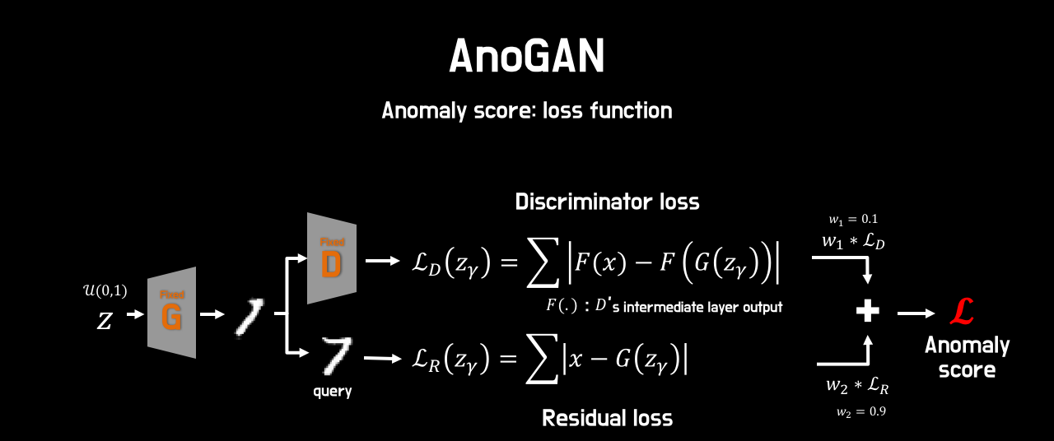
anoGAN for Unsupervised Anomaly Detection
Schlegl, Thomas, et al. "Unsupervised anomaly detection with generative adversarial networks to guide marker discovery." International Conference on Information Processing in Medical Imaging. Springer, Cham, 2017.

Slide 8
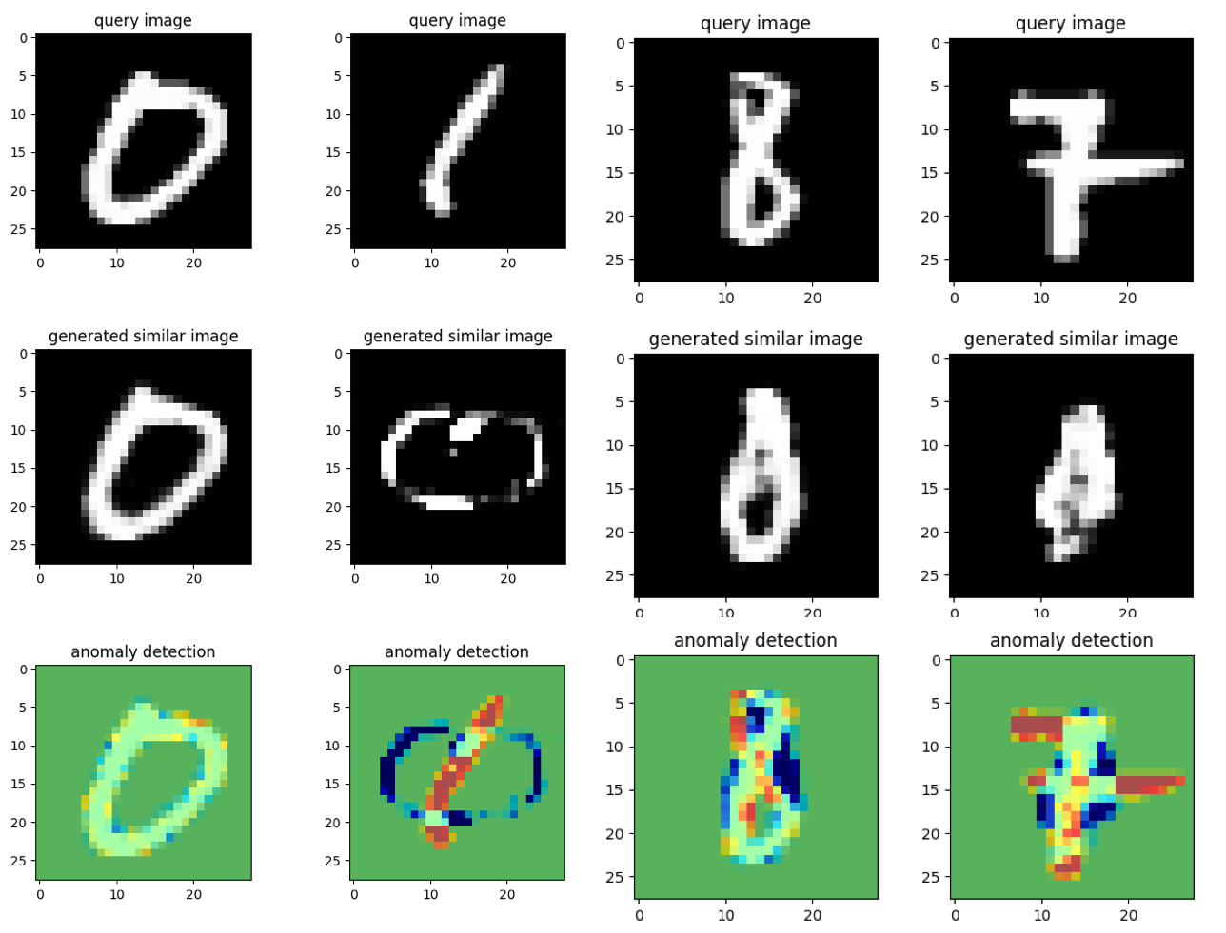
anoGAN for Unsupervised Anomaly Detection
Notes:
https://github.com/oyxhust/wgan-gp-anomaly (wgan-gp)
https://github.com/fuchami/ANOGAN (DCGAN)
https://github.com/kosyoshida/simple-keras https://github.com/tkwoo/anogan-keras
AnoGAN(code, keras) : https://github.com/yjucho1/anoGAN AnoGAN(code, tf) : https://github.com/LeeDoYup/AnoGAN

Slide 9
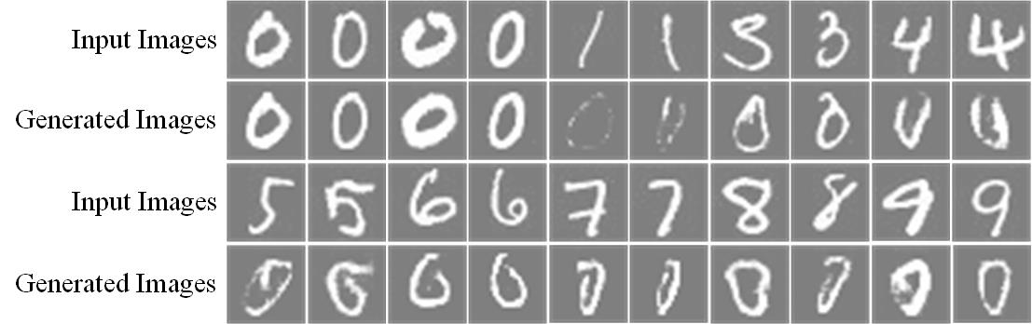
anoGAN for Unsupervised Anomaly Detection
Schlegl, Thomas, et al. "Unsupervised anomaly detection with generative adversarial networks to guide marker discovery." International Conference on Information Processing in Medical Imaging. Springer, Cham, 2017.
Notes:
https://github.com/oyxhust/wgan-gp-anomaly (wgan-gp)
https://github.com/fuchami/ANOGAN (DCGAN)
https://github.com/kosyoshida/simple-keras

Slide 10
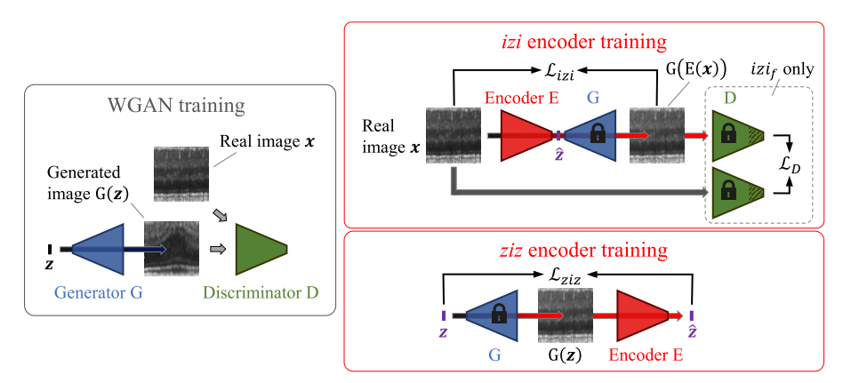
f-AnoGAN
Schlegl, Thomas, et al. "f-AnoGAN: Fast unsupervised anomaly detection with generative adversarial networks." Medical image analysis 54 (2019): 30-44.
Notes:
https://github.com/tSchlegl/f-AnoGAN

Slide 11
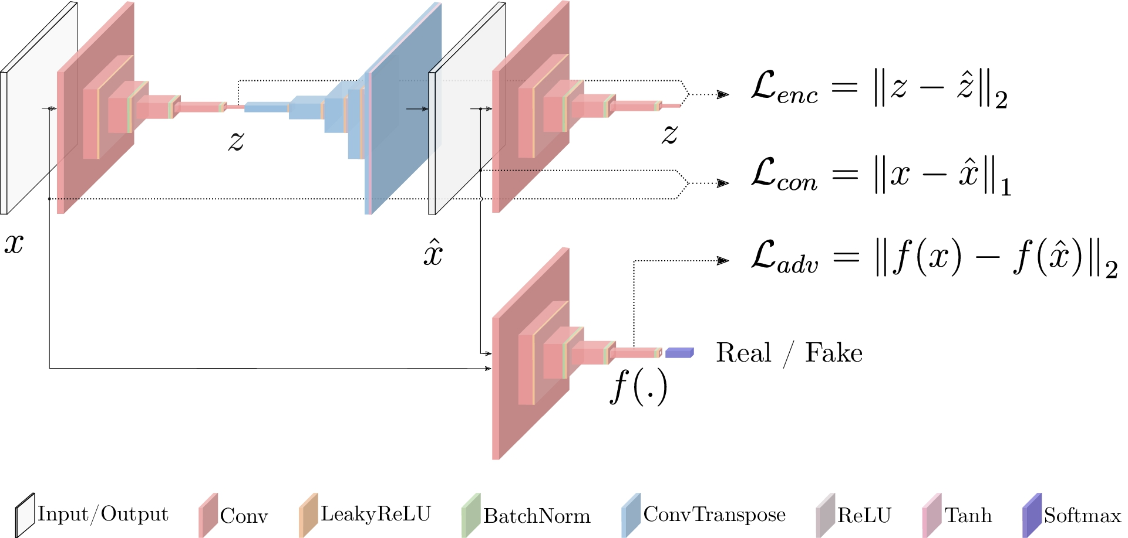
GANomaly
Akcay, Samet, Amir Atapour-Abarghouei, and Toby P. Breckon. "Ganomaly: Semi-supervised anomaly detection via adversarial training." Asian Conference on Computer Vision. Springer, Cham, 2018.
Notes:
https://github.com/WellenWoo/GANomaly-pytorch
https://github.com/aarthipriyar/GAN
https://github.com/samet-akcay/ganomaly
https://github.com/mimirobo/retina_ganomaly
https://github.com/samet-akcay/ganomaly
https://github.com/ucbtns/medgan
https://github.com/SunnerLi/GANomaly2D
https://github.com/gewenchao/anomaly-detection-semi-supervision

Slide 12
GANomaly
Akcay, Samet, Amir Atapour-Abarghouei, and Toby P. Breckon. "Ganomaly: Semi-supervised anomaly detection via adversarial training." Asian Conference on Computer Vision. Springer, Cham, 2018.
Notes:
https://github.com/WellenWoo/GANomaly-pytorch
https://github.com/aarthipriyar/GAN
https://github.com/samet-akcay/ganomaly
https://github.com/Scott1123/GANomaly

Slide 13
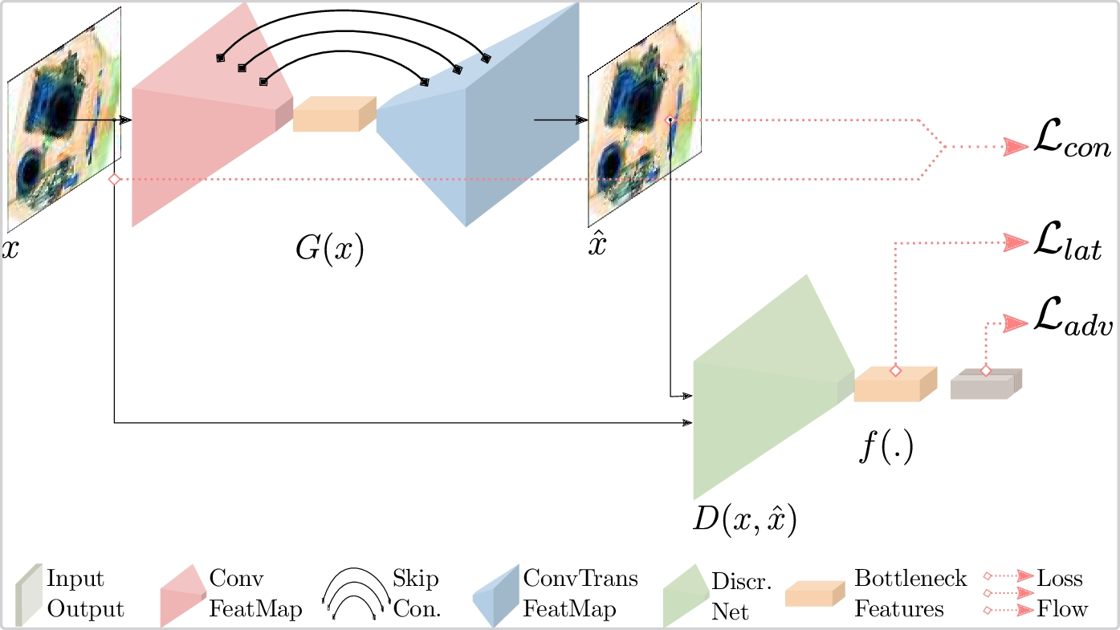
Skip-ganomaly
S. Akçay, A. Atapour-Abarghouei, T. P. Breckon, Skip-GANomaly: Skip Connected and Adversarially Trained Encoder-Decoder Anomaly Detection, in: International Joint Conference on Neural Networks (IJCNN), IEEE, 2019
Notes:
https://github.com/samet-akcay/skip-ganomaly

Slide 14
Efficient-GAN
Zenati, Houssam, et al. "Efficient gan-based anomaly detection." arXiv preprint arXiv:1802.06222 (2018).
Notes:
https://github.com/houssamzenati/Efficient-GAN-Anomaly-Detection
https://arxiv.org/abs/1904.02426v2 Efficient GAN-based method for cyber-intrusion detection
https://github.com/Forcrush/Efficient-GAN-based-method-for-cyber-intrusion

Slide 15
Fence GAN
Ngo, Cuong Phuc, et al. "Fence GAN: Towards Better Anomaly Detection." arXiv preprint arXiv:1904.01209 (2019).

Slide 16
MemAE
Notes:
https://github.com/h19920918/memae
Memorizing Normality to Detect Anomaly: Memory-augmented Deep Autoencoder for Unsupervised Anomaly Detection (MemAE)

Slide 17
CompactCNN
Notes:
https://github.com/msminhas93/CompactCNN
A Compact Convolutional Neural Network for Textured Surface Anomaly Detection
https://www.semanticscholar.org/paper/A-Compact-Convolutional-Neural-Network-for-Textured-Racki-Tomazevic/17d3f90cb63fbac50a5e49b8a46e633ec1f526fd#extracted

Slide 18
Image Completion
Notes:
https://arxiv.org/pdf/1811.06861.pdf Anomaly Detection using Deep Learning based Image Completion
https://github.com/oezguensi/anomaly-detection-image-completion

Slide 19
Lim, Swee Kiat, et al. "Doping: Generative data augmentation for unsupervised anomaly detection with gan." 2018 IEEE International Conference on Data Mining (ICDM). IEEE, 2018.
Notes:
https://github.com/greentfrapp/doping

Slide 20
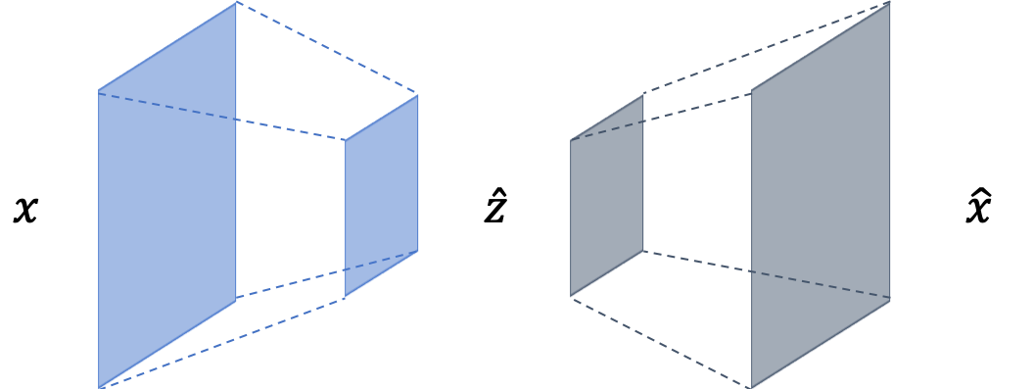
CVAE
Notes:
https://github.com/YeongHyeon/CVAE-AnomalyDetection

Slide 21
Adversarially Learned Anomaly Detection
Adversarially Learned Anomaly Detection" (authors: Houssam Zenati*, Manon Romain*, Chuan Sheng Foo*, Bruno Lecouat, Vijay Ramaseshan Chandrasekhar)
Notes:
https://github.com/houssamzenati/Adversarially-Learned-Anomaly-Detection

Slide 22
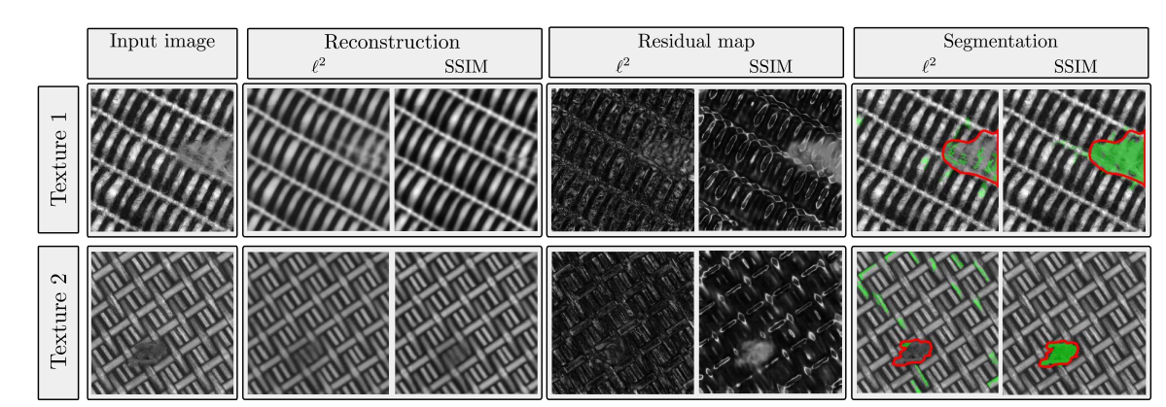
SSIM loss
Bergmann, Paul, et al. "Improving Unsupervised Defect Segmentation by Applying Structural Similarity to Autoencoders." arXiv preprint arXiv:1807.02011 (2018).

Slide 23
patch_gan_alocc
Notes:
https://github.com/jingkunchen/patch_gan_alocc

Slide 24
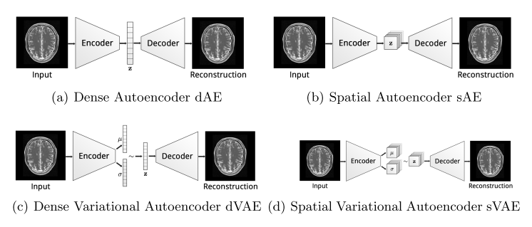
Spatial VAE
Baur, Christoph, et al. "Deep autoencoding models for unsupervised anomaly segmentation in brain mr images." International MICCAI Brainlesion Workshop. Springer, Cham, 2018.
Notes:
https://github.com/divelab/svae
https://github.com/tbepler/spatial-VAE
http://tongtianta.site/paper/61488
http://tongtianta.site/paper/61141

Slide 25
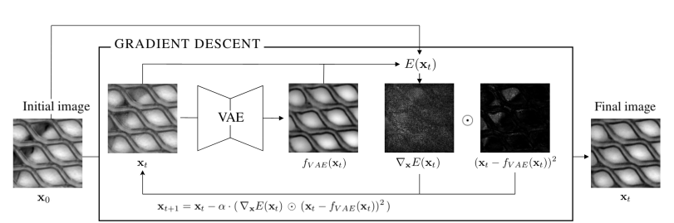
Structured Energy-Based VAE
Notes:
Iterative energy-based projection on a normal data manifold for anomaly localization http://tongtianta.site/paper/59419
Deep structured energy-based image inpainting
http://tongtianta.site/paper/25792 Deep structured energy-based image inpainting

Slide 26
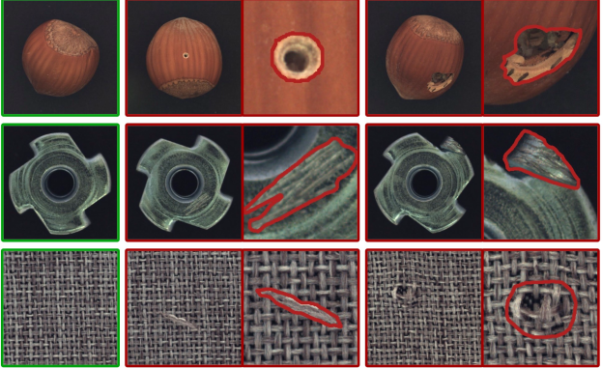
DataSet
Bergmann, Paul, et al. "MVTec AD--A Comprehensive Real-World Dataset for Unsupervised Anomaly Detection." Proceedings of the IEEE Conference on Computer Vision and Pattern Recognition. 2019.

Slide 27
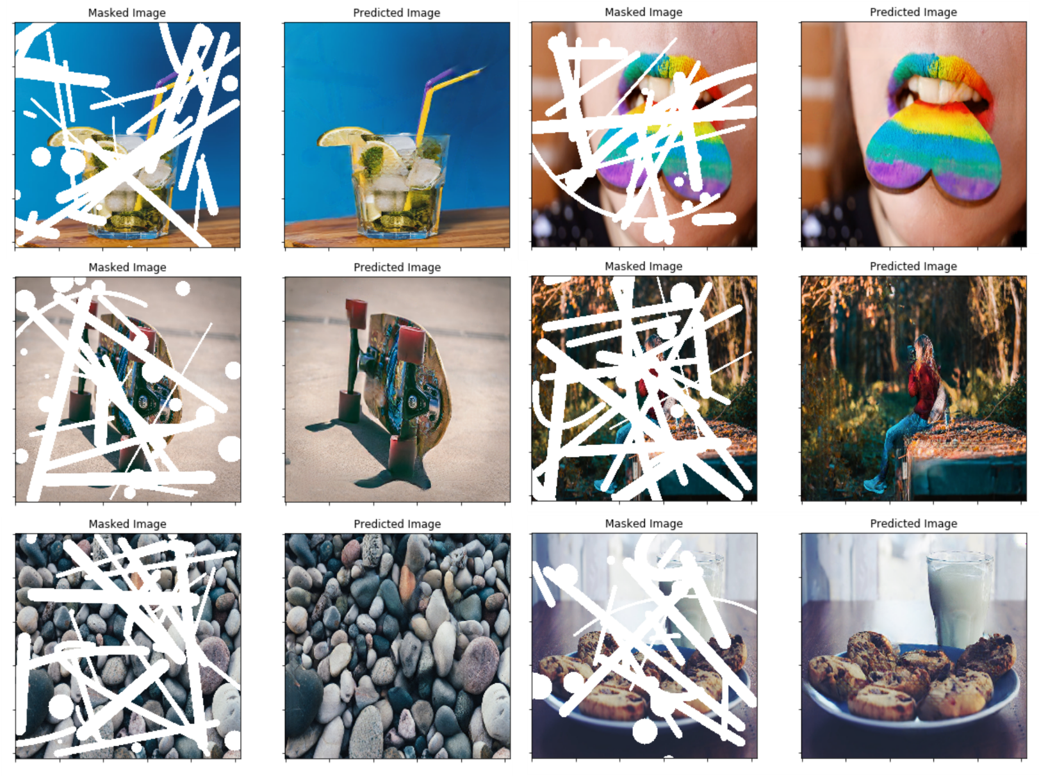
Partial Convolutions for Image Inpainting
Liu, Guilin, et al. "Image inpainting for irregular holes using partial convolutions." Proceedings of the European Conference on Computer Vision (ECCV). 2018.
Notes:
https://qiita.com/shinmura0/items/742adb4faefcfc8dd5cb
https://github.com/shinmura0/PConv-Keras

Slide 28
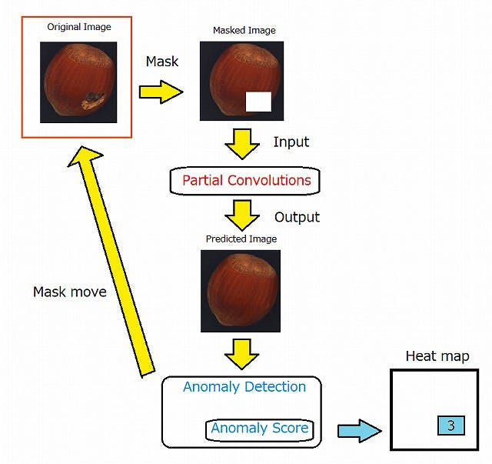
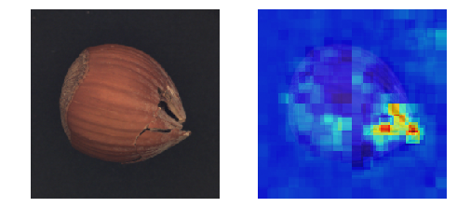
Ano-Unet
Notes:
https://qiita.com/shinmura0/items/742adb4faefcfc8dd5cb
https://github.com/shinmura0/PConv-Keras

